Slide 1

Exploring Amines & Diazonium Salts
Unveiling the structure, properties, and synthesis of these vital organic compounds.

Slide 2
UNIT OBJECTIVES
What You'll Learn
1
Understand Amines
Describe their pyramidal structure and classification.
2
Nomenclature
Learn common and IUPAC naming conventions.
3
Preparation & Properties
Explore key synthesis methods and chemical characteristics.
4
Distinguish Amines
Differentiate between primary, secondary, and tertiary types.
5
Diazonium Salts
Discover their preparation and role in aromatic synthesis.

Slide 3
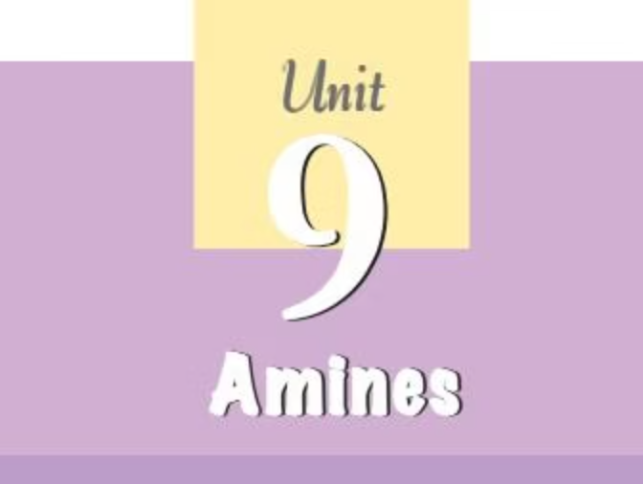
INTRODUCTION TO AMINES
Amines: Ammonia Derivatives
Amines are organic compounds formed by replacing one or more hydrogen atoms of ammonia (NH₃) with alkyl or aryl groups.
"The chief commercial use of amines is as intermediates in the synthesis of medicines and fibres."
They are found in nature in proteins, vitamins, alkaloids, and hormones, and are crucial in synthetic materials like polymers, dyes, and drugs.
Biologically active compounds like adrenaline and ephedrine contain secondary amino groups, while Novocain (anesthetic) and Benadryl (antihistamine) contain amino groups.

Slide 4
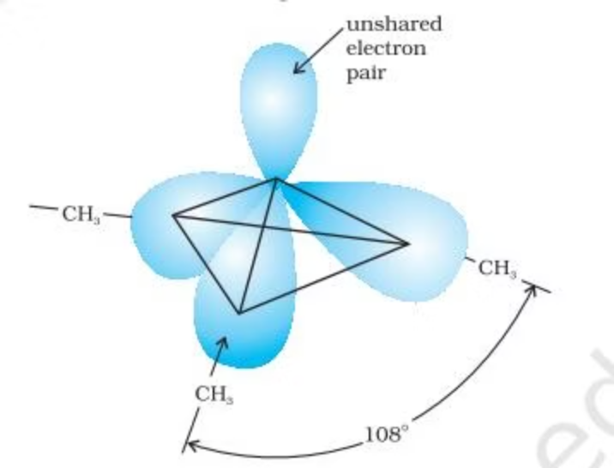
AMINE STRUCTURE
Pyramidal Geometry
Similar to ammonia, the nitrogen atom in amines is trivalent and possesses an unshared pair of electrons.
Nitrogen orbitals in amines are sp³ hybridized, resulting in a pyramidal geometry.
The unshared electron pair causes the C–N–E angle (where E is C or H) to be less than 109.5°, for example, 108° in trimethylamine.
This unique structure influences their reactivity and basic properties.

Slide 5



AMINE CLASSIFICATION
Primary, Secondary, Tertiary
Amines are classified based on the number of hydrogen atoms replaced by alkyl or aryl groups in the ammonia molecule.
Primary (1°)
Secondary (2°)
Tertiary (3°)
One hydrogen atom of ammonia is replaced (RNH₂ or ArNH₂).
Two hydrogen atoms of ammonia, or one from a primary amine, are replaced (R-NHR').
All three hydrogen atoms of ammonia are replaced (R₃N).
Amines are 'simple' if all groups are the same, and 'mixed' if they are different.

Slide 6
AMINE NOMENCLATURE
Naming Conventions
Amines are named using both common and IUPAC systems, with specific rules for alkyl and aryl groups.
CH₃-CH₂-NH₂
Ethylamine
Ethanamine
CH₃-NH-CH₂CH₃
Ethylmethylamine
N-Methylethanamine
(CH₃)₃N
Trimethylamine
N,N-Dimethylmethanamine
C₆H₅NH₂
Aniline
Benzenamine
The 'N' locant is used for substituents on the nitrogen atom in secondary and tertiary amines.

Slide 7
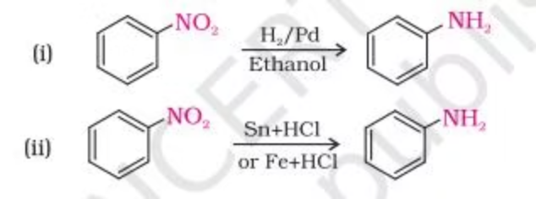
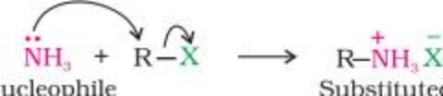
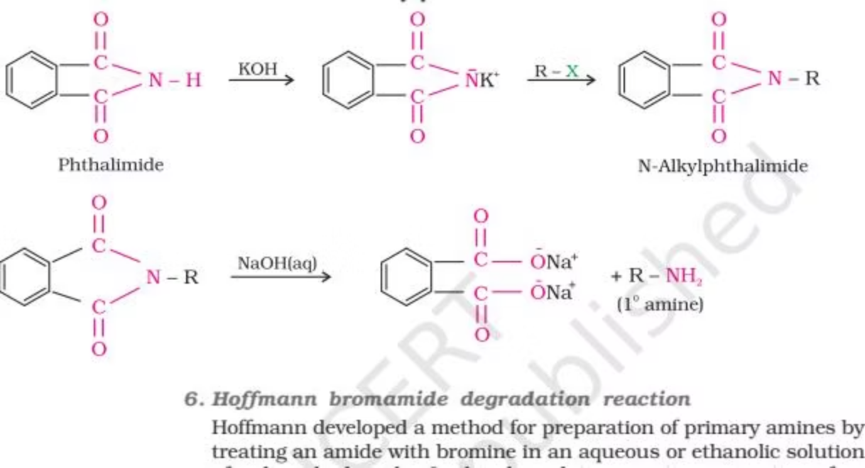
AMINE SYNTHESIS
Key Preparation Methods
Reduction of Nitro Compounds
Ammonolysis of Alkyl Halides
Nitro compounds are reduced to amines using hydrogen gas with catalysts (Ni, Pd, Pt) or metals in acidic medium.
Alkyl/benzyl halides react with ethanolic ammonia, replacing halogen with an amino group. This can yield a mixture of primary, secondary, and tertiary amines.
Reduction of Nitriles & Amides
Gabriel Phthalimide Synthesis
Nitriles reduce to primary amines using LiAlH₄ or catalytic hydrogenation. Amides yield amines upon reduction with LiAlH₄.
A specific method for preparing primary amines from phthalimide and alkyl halides. Aromatic primary amines cannot be prepared this way.

Slide 8
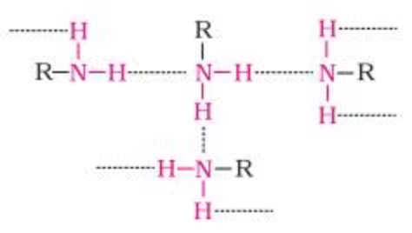
AMINE PROPERTIES
Physical Characteristics
State & Odor
Boiling Points
Lower aliphatic amines are gases with a fishy odor. Higher amines are liquids or solids. Aniline and arylamines are colorless but oxidize on storage.
Primary and secondary amines exhibit intermolecular association via hydrogen bonding, leading to higher boiling points. Tertiary amines lack this, resulting in lower boiling points.
Solubility
Order of boiling points for isomeric amines:
Lower amines are water-soluble due to hydrogen bonding. Solubility decreases with increasing molar mass. Amines are soluble in organic solvents.
Primary > Secondary > Tertiary

Slide 9



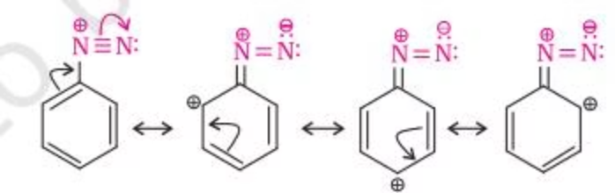
DIAZONIUM SALTS
Versatile Intermediates
Diazonium salts (ArN₂⁺X⁻) are crucial for synthesizing various aromatic compounds, including dyes.
Preparation
Stability
Reactions
Formed by diazotization of primary aromatic amines with nitrous acid at low temperatures (273-278K).
Arenediazonium salts are stable for short periods in solution due to resonance.
Undergo displacement of nitrogen (Sandmeyer, Gatterman reactions) and retention of the diazo group (coupling reactions).

Slide 10

CONCLUSION
Key Takeaways
Amines
Reactivity
Derivatives of ammonia with pyramidal structure, classified by hydrogen replacement. They are basic due to nitrogen's unshared electron pair.
Influenced by the number of hydrogen atoms on nitrogen, allowing for distinction between primary, secondary, and tertiary amines.
Diazonium Salts
Crucial intermediates for synthesizing various aromatic compounds and azo dyes through displacement and coupling reactions.

